Slide 1

Kyle Ignacio, Michala Li, Aditi Mittal,
AmirAli Omidfar, Pariya Samandi

Slide 2
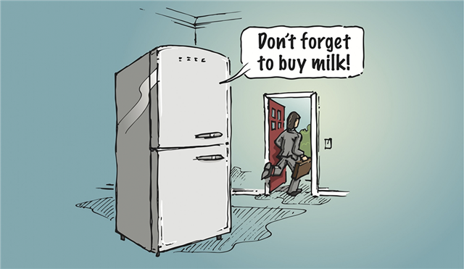
Problem:
Notes:
Unmet need
Michala
In today’s fast paced world, efficiency and convenience have become many people’s priority. Daily tasks are constantly being optimized for efficiency. Takeout, online shopping, ubering are all examples of that. An area that we feel can be further optimized is grocery shopping and we begin introducing our product with Adam’s story. Adam is a college student living in an apartment with several other roommates. They rotate grocery shopping responsibilities every week. A common issue that arises for Adam is that when he goes grocery shopping, he often forgets what they need and what they have left, in particular milk.

Slide 3

Solution: Milky
Easy to Install Inside of Fridge
No clamping required
No assembly required
No jutting parts
Simple App Interface
No alert fatigue
Fast loading time
Compatible with iOS 10 and Android 9
Notes:
Michala

Slide 4
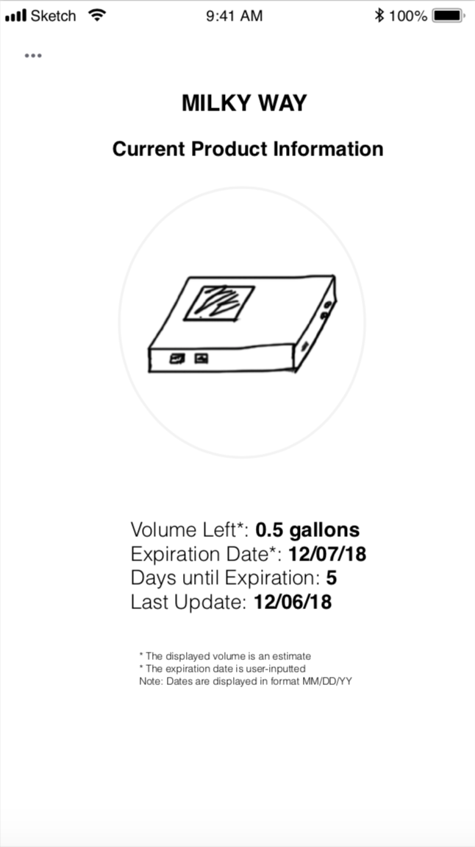
Key Attributes
Notification of expiration date
Simple app interface
Easy to install inside of fridge
Notification of remaining liquid volume
Data from last time fridge opened
Notes:
Pariya

Slide 5
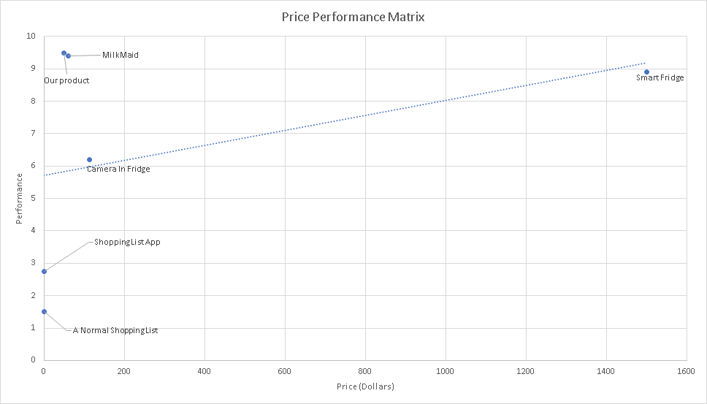
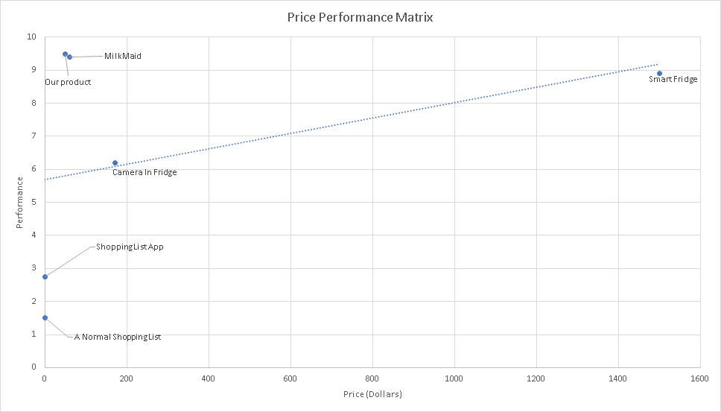
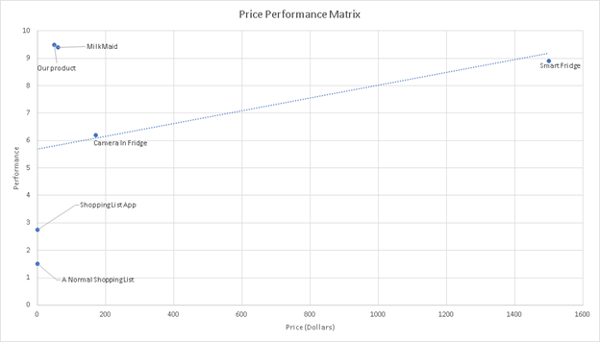
Price Performance Chart
Notes:
2. Price performance chart
Here is our price performance chart. As you can see, the Samsung Smart Fridge is expensive compared to our product and our competitors. Although the normal shopping list and shopping list app are cheap, they do not address the key attributes of the unmet need that well. Our main competitor, which I will talk about in the next slide, is MilkMaid.

Slide 6
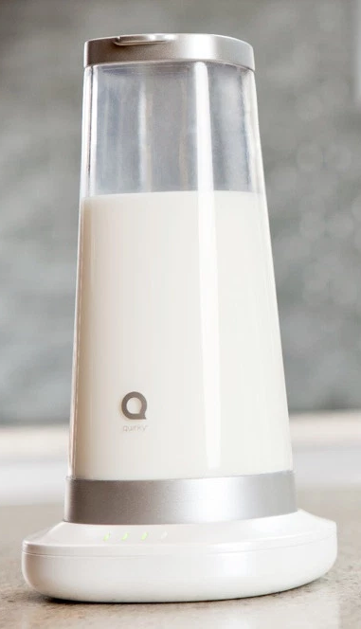
MilkMaid
Parts Of Unmet Need Addressed
Reports when milk is low
Text message feature
Reports when milk expires
Differences
Only concerns milk
More effort in routine usage
Notes:
Milkmaid addresses an unmet need that is most similar to the one of Milky. Milkmaid, the award-winner in a competition held by the inventor-driven site, Quirky, and General Electric, weighs the milk inside its vessel and tells the user via text message when he or she needs to buy more milk. Milkmaid also comes with a pH sensor, which is used to test if the milk is spoiled. If Milkmaid senses that the milk has spoiled, it reports this information to the user as well. Overall, Milkmaid is a great solution for those who go out shopping and forget how much milk they have left. Although MilkMaid is not out in the market yet, the creators are optimistic and continue to receive funding.
Although MilkMaid provides many features regarding milk, Milky is still the product to choose to determine remaining liquid volume. First, Milky is able to determine the remaining liquid volume of multiple liquids, not just milk. This functionality allows users to interchange among different liquids, in effect allowing a more general use of Milky. Second, Milky requires less effort in routine usage. In order to reuse MilkMaid, the user must clean any residue from leftover milk and pour in the milk they have from their container into MilkMaid’s vessel. However, Milky only requires that the user put the container onto the scale and input information into the app. With the user input, Milky will also be able to determine remaining liquid volume and expiration of the liquid. All in all, MilkMaid may provide competition to Milky, but the general applications and ease of routine usage of Milky will allow it to pass MilkMaid in the market.

Slide 7
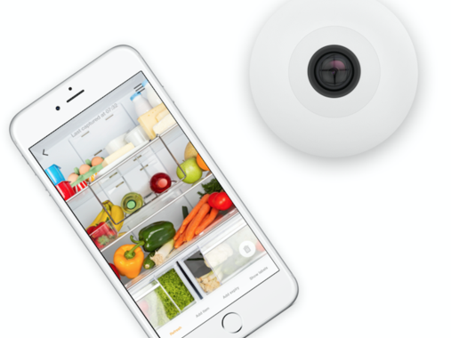
Camera in Fridge
Parts of Unmet Need Addressed
Easy to install and use
Visual of inside contents
Differences
Provides no data except visual
Issue of obstructions
Notes:
For 113 USD, the Smarter Fridge-Cam offers a solution for shoppers who forget what is in their fridge. To install Smarter Fridge-Cam, the user anchors the camera to a spot in the fridge. The camera then connects with the user’s phone via an app, and the user is then able to check what is in their fridge when they forget what is inside. Although the Smarter Fridge-Cam offers a solution to forgetful shoppers, it does not provide an estimate of remaining liquid volume. Instead, the Smarter Fridge-Cam offers a visual, and the camera’s field of vision may be obstructed by other tall objects inside the fridge. Therefore, users will have to worry about the placement of items in their fridge, which requires more effort on the user’s part. Since the Smarter Fridge-Cam does not provide an estimate of remaining liquid volume as well as Milky does, we do not see the Smarter Fridge-Cam as a threat to business. The Smarter Fridge-Cam is also considerably more expensive than Milky. Overall, Milky will generate more positive user reviews due to the factors outlined above.

Slide 8
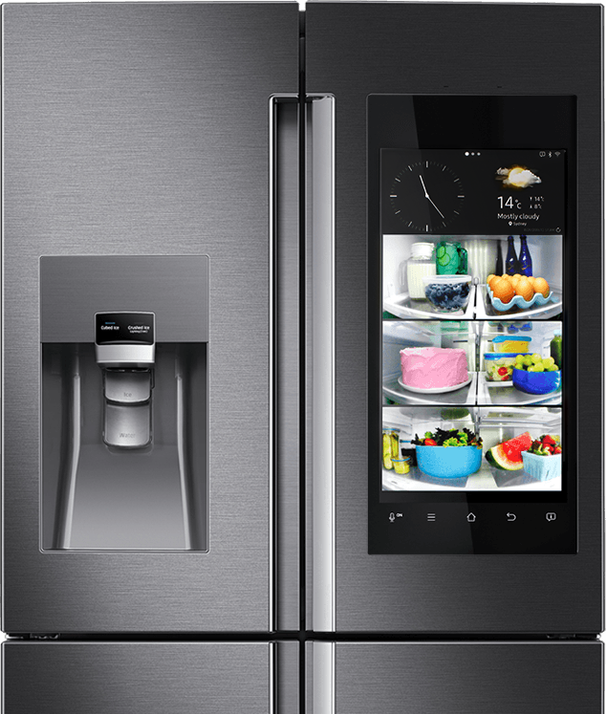
Smart Fridge
Parts of Unmet Need Addressed
Data of inside contents
Easy to use
Differences
Expensive
Many miscellaneous features
Notes:
The Samsung Smart Fridge is a sleek and compact fridge that promises only the best of technology for buyers. There are multiple designs that contain many shelves, allowing families to categorize their inventory with ease. Each section undergoes its own refrigeration cycle, using less energy overall. The fridge resembles a large block, so it fits in well into the kitchen. All in all, the Samsung Smart Fridge offers an “upgraded” version of the fridge. However, if one only wants to check how much of a consumable liquid they have left in their fridge, the Samsung Smart Fridge is not the solution. The cheapest Smart Fridge sells at 1500 USD. This may be a fair price for a family that wants to upgrade their fridge and fit the fridge with the sleek aesthetic of their kitchen, but it is not a price to pay if a family wants a device that reports the remaining volume of a liquid if they forget while shopping. Since the Samsung Smart Fridge is more focused on the future of the fridge itself in American households than reporting remaining liquid volume, we do not consider the Samsung Smart Fridge as a threat to business.

Slide 9


(cloud server)
Weight data
Weight data
(hardware device)
(app)
Notes:
System overview
three main sections
Hardware —> Milky device
Cloud server
App (user interface)

Slide 10
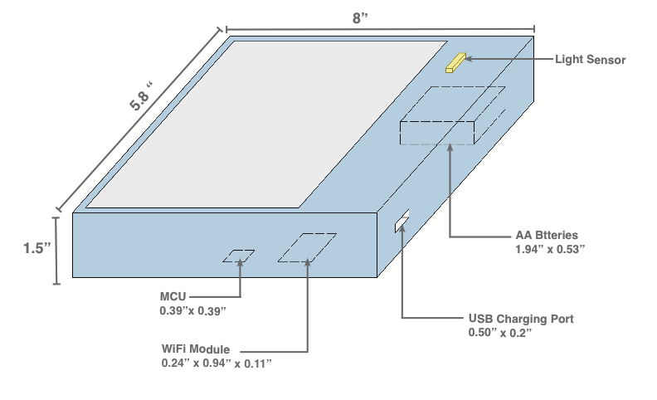
Milky Device
BOM
Design Schematics
Level | Item No | Description
1 | Electronics System
2 | FSR 406 | Weight sensor (Force sensitive resistor)
2 | ESP-12E | WiFi Module
2 | STM32F205 | The STM 32-BIT Arm MCU
2 | 803048 | AA rechargeable battery
2 | TSL2591 | luminosity (light) sensor
2 | 3021009-06 | USB charging cable
1 | ABS-1KG1.75-BLK | ABS filament used for hardware case material
Notes:
Milky Device
Two main systems
Electronics
Casing material —>
Impact resistance/chemical resistance
Excellent High and Low Temperature Performance
Great Electrical Insulation Properties
https://www.plasticextrusiontech.net/resources/what-is-abs-material/

Slide 11
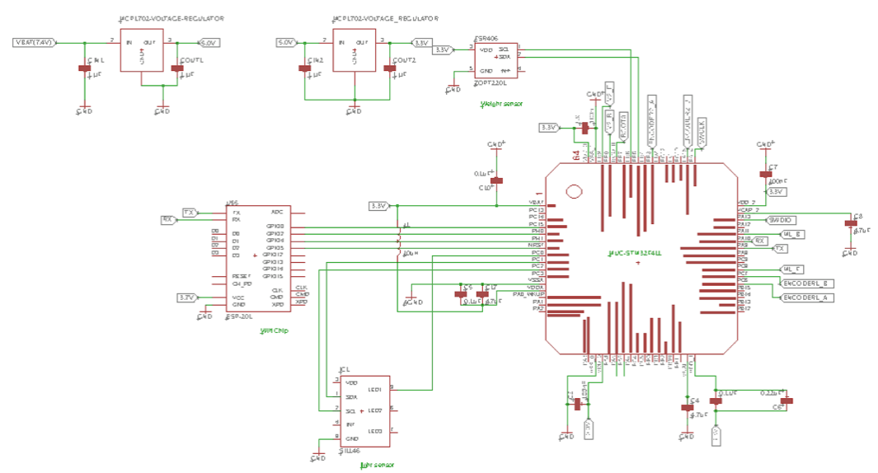
Electronics
Wiring Diagram
Notes:
Electronics
Main components —> weight and light sensors, MCU and wifi chip
Design PCB based on this —> for prototype testing

Slide 12

Dweet Cloud Server
Notes:
Dweet Cloud Server
Publishing and Subscribing server for machines, sensors, devices, robots,
Simple and easy to use —>
By default, data can be stored on the server for up to a month
Each time 140 characters can be sent

Slide 13
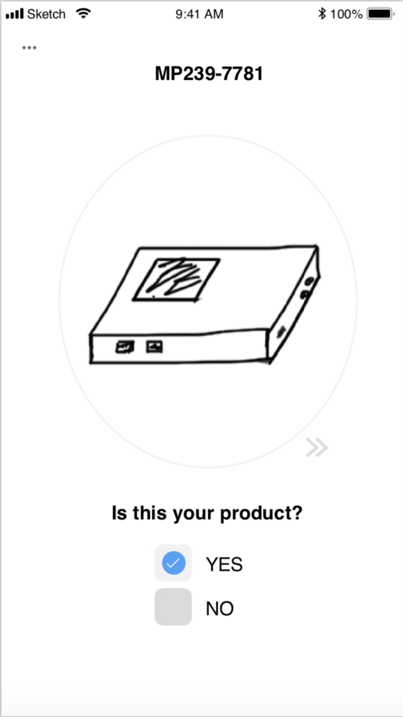
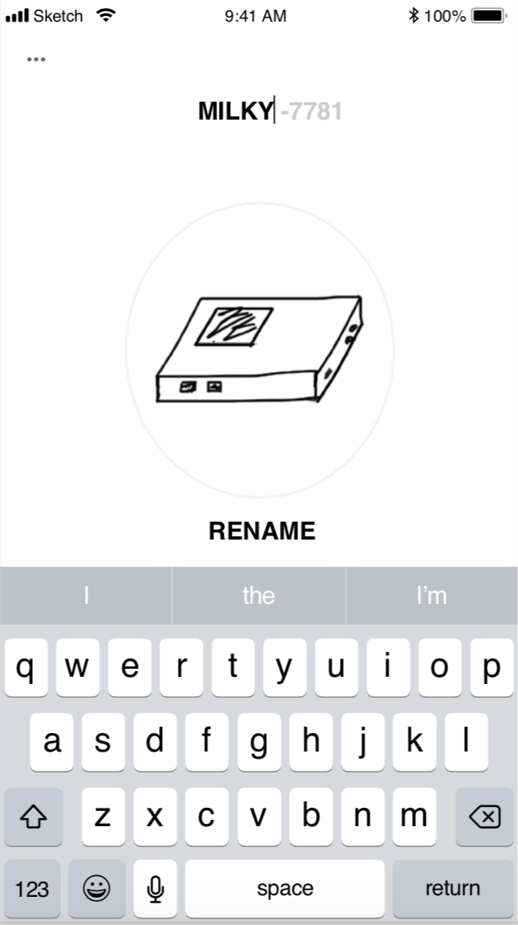
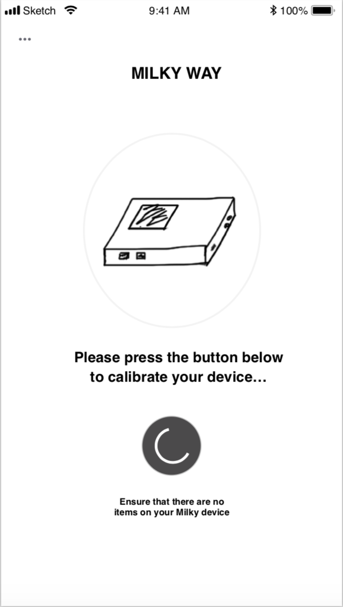
1 - Synchronization
2 - Rename Device
3 - Weight Calibration
Notes:
Aditi

Slide 14
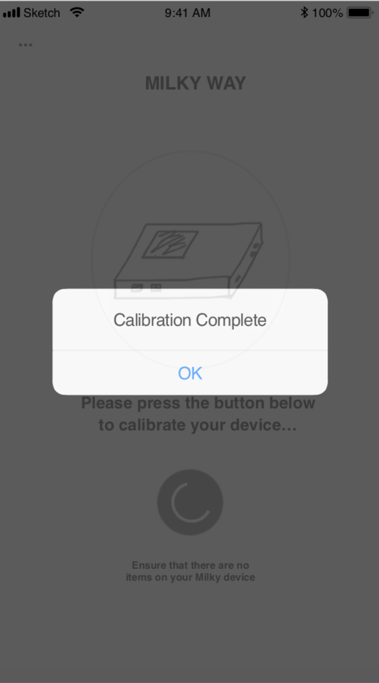
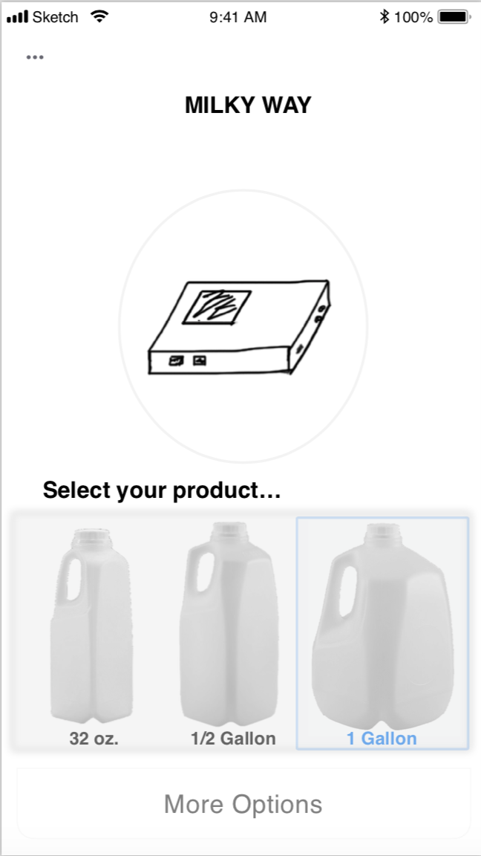
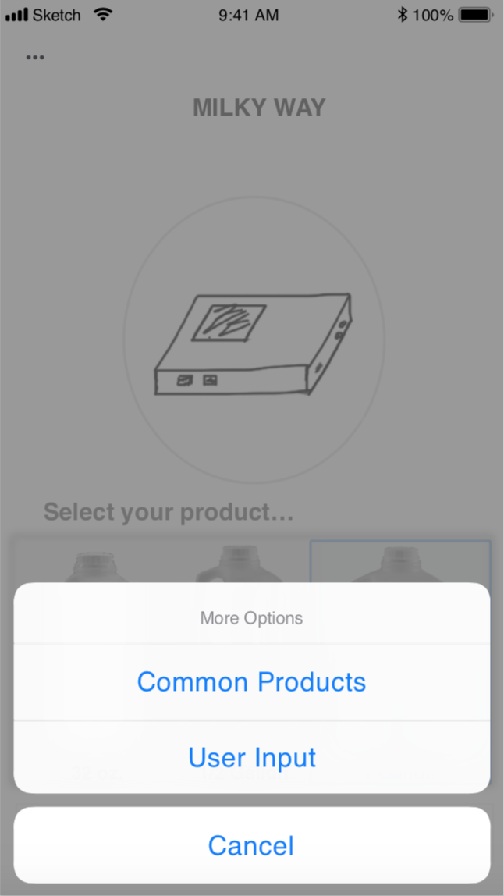
4 - Calibration Complete
5 - Select Container Type
6 - Select Liquid Type
Notes:
Aditi

Slide 15
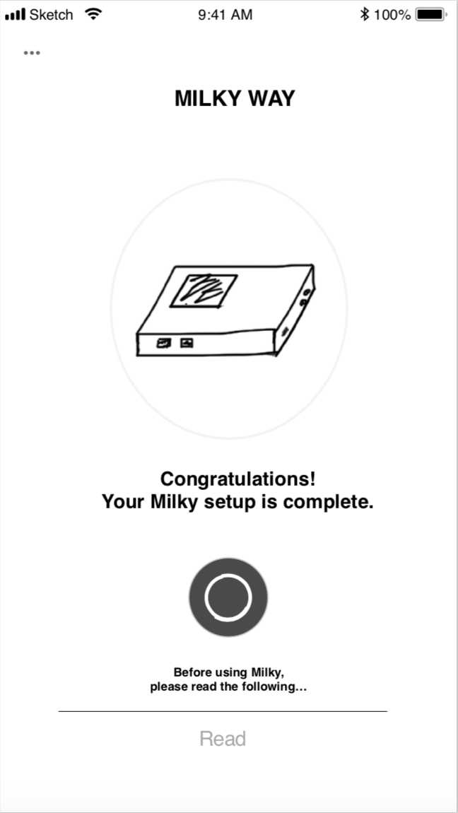
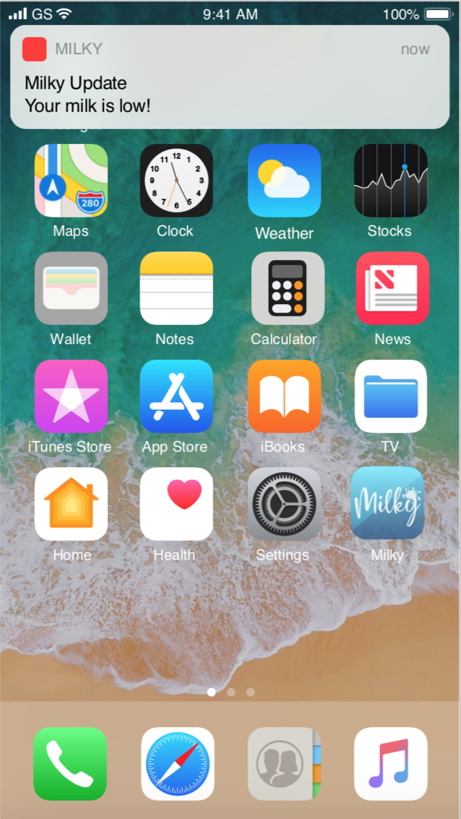
7 - Setup Complete
8 - App Notifies User
9 - Product Info Display
Notes:
Aditi

Slide 16
Specifications
Left Hand Specifications | Right Hand Specifications
Notification of remaining liquid volume Date from last time fridge opened | Wifi module specs Temperature range of the chip :-40˚C and 125˚C Signal transmission when door opens
Notification of expiration data | New Item process Customizable settings Dweet.io character limit (140- Date strings 20 characters) Dweet update time
Simple app interface | No alert fatigue, Compatible with iOS 10 and Android 9 platform
Easy to install inside of fridge | Dimensions of the scale (1.5”x5.8”x8”) allow Milky No assembly of device required
Notes:
Specifications :
Notifications and data when door opens : 802.11 protocol - 2.4GHz radio frequency - Avoid signal degradation by transmitting only when door is open
Notification of expiration date: up to user
simple app interface : Customizable
Easy to install inside the fridge: 5.8 —> between 5.5 (max milk gallon) 6 being how wide the side rack are in fridges

Slide 17
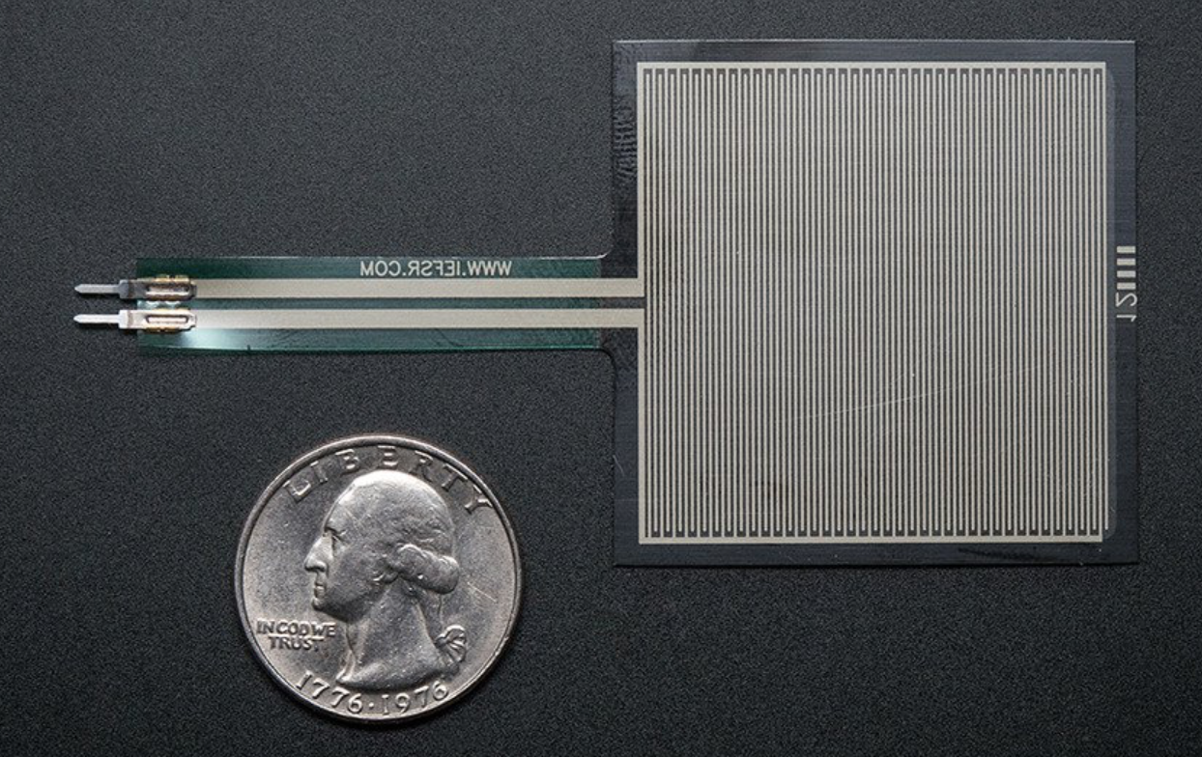


Proof of Concepts
Hardware:
Resistive force sensor
Mechanism
I2C communication protocol
Definition
Light sensor
Mechanism
Server Details
IP clearance
Milkmaid
How we are different from them
Notes:
Proof of Concepts:
Hardware
Resistive force sensor : no force infinite resistance —> force applied less resistance —> voltage
https://learn.adafruit.com/force-sensitive-resistor-fsr/using-an-fsr
I2C: bus protocol : short-distance, serial data transfer. multiple server/master, compatible with our sensors
https://bitwizard.nl/wiki/SPI_versus_I2C_protocols
light sensor —> two photodiodes with ADC
Server details
Update rate 50 secs —> (not real time data streaming good enough for our purposes)
our process update 1-1:30
21-25 times of fridge door opening
https://www.housebeautiful.com/uk/lifestyle/storage/news/a2110/fridge-food-cupboard-habits/
IP clearance
no container is given for ours
No PH measurement —> when the milk is about to turn
Weight measurement —> as we want to see how much milk is left
https://newatlas.com/milkmaid-smart-jug-milk-app/22891/
---------------------------------
Q/A
Signaling issue —> use usb dongle up 1km different wifi chip nRF24LU1
20dBm power amplifier —> give up to 1km radio range

Slide 18
Program Risk: MilkMaid (Similar Product)
Reports volume of remaining milk
Notifies user when milk reaches expiration date
Utilizes pH sensors for accuracy
Mitigation
Liquids other than milk can be used in Milky
Liquid does not need to be transferred to unique vessel
Notes:
dt

Slide 19

FMECA Issue: Incorrect Expiration Date Output
Liquid left out for too long
Logging Liquid 1 into Milky, later accidentally placing Liquid 2 onto Milky (with diff. expiration)
Mitigation - Milky warns user prior to use
Notes:
dt

Slide 20

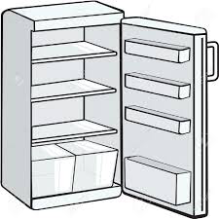
FMECA Issue: Incorrect Liquid Volume Output
Wrong liquid input into app
Liquid container only partially on scale
Item falls onto weight scale
Mitigation - warns user, notifies user when weight changes
TOO MUCH MILK
NO MILK
Notes:
dt

Slide 21
FMECA Issue: Loss of Functionality in Device
Spilling liquids onto Milky
Placing Milky in freezer
Exposing Milky to hot temperatures
Wifi not working
Component breakage
Mitigation
Component calibration prior to use
Informs user when device is not functioning
Informs user when wireless capabilities not functioning
Notes:
dt

Slide 22

Financial Overview
Non-Recurring Engineering Cost
Labor Cost | $139,520
Risk Inventory | $372,000
Capital Investment | $94,000
Notes:
Michala
Our research and development team consists of mechanical engineers, electrical engineers, testing personal, and a program manager.
Our risk inverntory
The risk inventory accounts for the cost of raw materials for our product. The purchase of raw materials was optimized by accounting for the minimum amount of materials that must be purchased at one time to minimize cost. The risk inventory was found to be $372,000.
The capital investment for Milky includes the cost of all machines and devices for the assembly of Milky devices as well as the app development cost as it can be considered a one-time fee. The capital investment cost came to be $94,000.

Slide 23
Financial Overview
Recurring Engineering Cost
Assembly Cost
= Time/unit x Salary x Number of Assemblers
BOM | $8.90
Assembly | $2.70
Notes:
Michala

Slide 24
Financial Overview
Price $50
Breakeven
The break even cost is equal to:
N=Σ Dev. Cost / [Price-(BOM + Assembly Cost)]
15,769 units to breakeven.
Notes:
Michala
We think that this is reasonable.

Slide 25
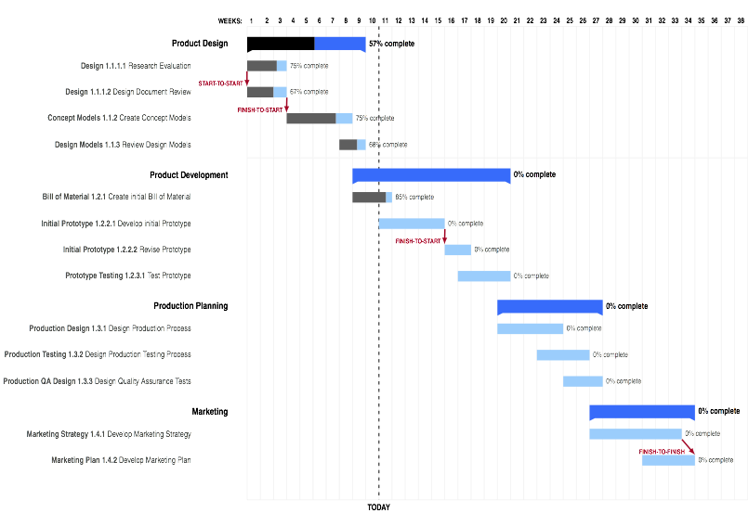
Notes:
Michala

Slide 26
Summary
With Milky, anyone can keep track of how much milk (reasonable approx.) they have left
Users can check their Milky app on their phone for their milk (or other liquid) data
Notes:
Pariya

Slide 27
Recommendation
More research is required to ensure that Milky meets our customers needs
Trials should be run to test user variability
Notes:
Pariya

Slide 28
Thank You

